Slide 1

TxDOT Project 0-6894: Guidelines for Design and Operation of U-turns
Project Team Kickoff Meeting
Austin, Texas
October 6, 2015

Slide 2

Task 1. Project Management
Prepare status reports (monthly)
Project Panel meetings (twice a year)
Document project meetings
Final products and deliverables
Final Research Report
Project Summary report
Self-Calculating Spreadsheet Tool for Safety Prediction
Technical Memoranda at end of each task
5

Slide 3

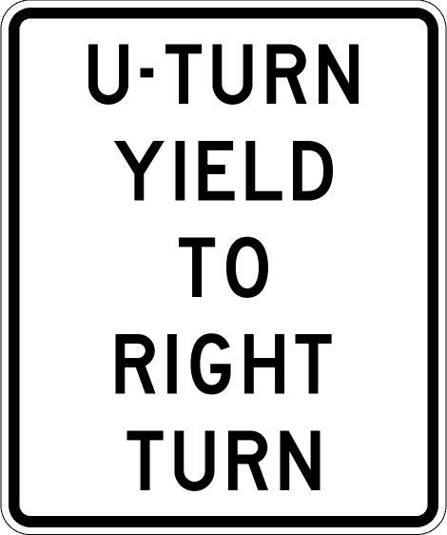
Task 2. ID & Explore Factors Affecting U-turn Use and Solutions for When U-turn Demand Exceeds Capacity
Factors Possibly Affecting Capacity
Traffic volumes and patterns
Interchange geometrics
Signal Operation (cycle length, phasing, splits)
Signage (typically yield)
Right-turn demand from the cross-street
Driveway access near the interchange
Downstream entry ramp
Distance, volume, metered?
6

Slide 4

Task 2 (Continued).
Factors Possibly Affecting Demand
Lane use/assignment
Nearby development intensity
Proximity and number of nearby driveways
Ramp configuration (Diamond or “X”) and interchange spacing
7

Slide 5

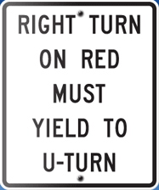
Task 2 (Continued).
Potential Solutions and Techniques for Improving U-turn Efficiency (Operations Solutions)
Modify signal timing plans to reduce queue length and facilitate access to lanes or bays at the start of each U-turn
Modify signal timing plans to facilitate access to frontage road lanes at the end of each U-turn and/or signalized control of the U-turn approach
Right-turn on red (RTOR) restrictions on cross-street to reduce the conflicts between U-turning and right-turning traffic
8

Slide 6
Task 2 (Continued).
Potential Solutions and Techniques for Improving U-turn Efficiency (Geometric/Access Solutions)
U-turn bay extensions or added lane(s) to facilitate entry to the U-turn lane
Two-lane U-turn lanes to add capacity for unusually high traffic demand
Access controls or driveway closure near the interchange U-turn lane
Access controls for either the U-turn lane or the right-turn lane from the arterial to remove the conflict between these two movements (painted solid line or barrier)
Acceleration lane for U-turn merge
9

Slide 7
Task 2. What do we need to do?
Literature Review to ID factors and their relevance
State of the practice assessment (TxDOT Districts)
Contact traffic operations engineer or design engineer
Obtain information about factors affecting U-turn use
Ask about solutions used and tried
Ask about well-performing and problematic ones
High / Low crash rates
High / Low delay
Try to ID a couple possible study sites from each district
10

Slide 8
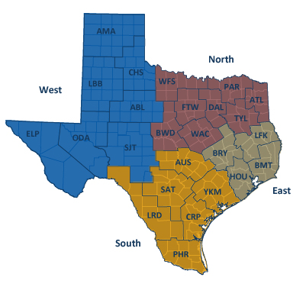
Task 2. Questions for Districts
Insight into factors affecting demand
Lane use/assignment (specifics)
Temporary (construction/detours)
Short-term (freeway wrecks)
Factors affecting capacity
Geometrics
U-turn traffic control
What is typically used in the district?
Ask districts about potential solutions
What documents are used in U-turn design?
11

Slide 9
Task 3. Determine Demand and Capacity of U-turn Lanes Under Various Conditions
Create simulation models (VISSIM specified in proposal) for >= 25 diamond interchanges
Calibrate to field conditions and run models to get performance measures for U-turns operating in several scenarios:
# Stops
Delay
Queue length
Throughput
12

Slide 10
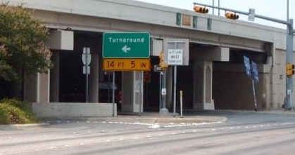
Task 3 (Continued).
Sources of data
Existing archive of counts and existing models
Many diamonds in South Texas from San Antonio office
Some in Houston from Houston office
Collecting data at additional sites
Plan to collect data at 10-15 new sites
Data to be collected
Volumes (per movement)
Geometrics
Factors (from task 2)
Signal timing data
From controller, maybe real-time performance data
13

Slide 11
Task 4. Determine Operational Effectiveness of Solutions
Apply solutions to resolve operational issues ID’d at previously selected study sites
Evaluate effectiveness with VISSIM models
Get MOEs and compare to results from Task 3
Field test at two sites
Non-geometric solutions
Collect field data like in task 3
Before vs. after comparison
14

Slide 12
Task 5. Safety Evaluation of U-turn Designs
Cross-sectional safety analysis for existing U-turn configurations
Qualitative evaluation
Collision diagrams
Three years of data
15 case study locations
Quantitative evaluation
Larger sample size (>= 60 locations)
Statistically developed safety performance function to predict # and severity of crashes
Equations for Self-calculating spreadsheet (Deliverable)
15

Slide 13
Task 6. Develop & Prepare Guidelines
Develop guidelines for use, design, and operation of U-turn lanes at diamond interchanges
Based on results of previous tasks and feedback from panel
Format should be for possible inclusion in Roadway Design Manual
16

Slide 14
Task 7. Prepare Project Documentation and Project Close
Develop final report and project summary report (Deliverables)
Produce self-calculating spreadsheet tool for predicting safety of U-turn lanes at diamond interchanges (Standalone product Deliverable)
Conduct close-out meeting
17

Slide 15
Schedule
Task | FY 2016 |  |  |  |  |  |  |  |  |  |  |  | FY 2017
 | Sep | Oct | Nov | Dec | Jan | Feb | Mar | Apr | May | Jun | Jul | Aug | Sep | Oct | Nov | Dec | Jan | Feb | Mar | Apr | May | Jun | Jul | Aug
Task 1
Task 2
Task 3
Task 4
Task 5
Task 6
Task 7
Deliverables |  |  |  | * |  |  |  |  |  | * |  |  |  |  | * |  |  | * |  |  | * |  |  | ***
* Deliverable at end of each Task 2-6
*** Three Deliverables at end of Task 7
(Final Report, Project Summary Report, Self-calculating spreadsheet Tool)
18

Slide 16
Assistance from TxDOT
Input from Project Panel throughout project
Task 2. Contact with districts (Help identify factors, solutions, and potential sites)
Task 4. Field Evaluations
Traffic Control
Assistance in implementing timings in controllers, if timing changes are identified as a solution
Potential need to procure and install signage, if sign(s) are identified as solution
Task 6. Feedback on guidelines
19

Slide 17

Extra Notes – Panel Questions
“U-turns” also known at Turnaround Lanes
This project will focus on U-turn lanes at diamond interchanges
Questions to be asked of the districts (input welcomed)
List of factors to be investigated (input welcomed)
Suggestions of study sites?
20

Slide 18
Next Steps
Complete literature review
Begin contacting districts
Identify factors
Identify possible solutions
Identify potential sites
Develop list of relevant factors to be used in Task 3
21

Slide 19

Questions?
22

